Slide 1
Linear Algebra
Lecture 24

Slide 2
Vector Spaces

Slide 3
Dimension of a
Vector Space

Slide 4
Recall
A vector space with a basis B containing n vectors is isomorphic to R^{n}.
‘n’ is intrinsic property called Dimension

Slide 5
Theorem
If a vector space V has a basis B = {b₁, … , b_{n}}, then any set in V containing more than n vectors must be linearly dependent.

Slide 6
Theorem
If a vector space V has a basis of n vectors, then every basis of V must consist of exactly n vectors.

Slide 7
Definition
If V is spanned by a finite set, then V is said to be finite-dimensional, and the dimension of V, written as dim V, is the number of vectors in a basis for V.

Slide 8
continued
The dimension of the zero vector space {0} is defined to be zero.
If V is not spanned by a finite set, then V is said to be infinite-dimensional.

Slide 9
Example 1
The vectors spaces R^{n}, P_{n}, M_{mn} are finite- dimensional. The vector spaces
F (-inf, inf), C (-inf, inf), and C^{m} (-inf, inf) are infinite- dimensional.

Slide 10
Example 2

Slide 11
(a) Any pair of non-parallel vectors a, b in the xy-plane, which are necessarily linearly independent, can be regarded a basis of the subspace R². In particular the set of unit vectors {i, j} forms a basis for R² in dim (R²) = 2.

Slide 12
Any set of three non coplanar vectors {a, b, c} in ordinary (physical) space, which will be necessarily linearly independent, span the space R³. Therefore any set of such vectors forms a basis for R³. In particular the set of unit vectors {i, j, k} forms a basis of R³. This basis is called standard basis for R³. Therefore dim (R³) = 3.

Slide 13
The set of vectors {e¹, e², …, e^{n} } where e¹ = (1, 0, 0, 0, …, 0), e² = (0, 1, 0, 0, …, 0)
e³ = (0, 0, 1, 0, …, 0), …, e^{n} = (0, 0, 0, 0, …, 1) is linearly independent. Moreover any vector
x = (x¹, x² , …, x^{n}) in R^{n} can be expressed as a linear combination of these vectors as
x = x¹e¹ + x²e² + x³e³ +…+ x^{n}e^{n}. Hence the set {e¹, e², …, e^{n}} forms a basis for R^{n}. It is called the standard basis of R^{n} therefore dim (R^{n}) = n. Any other set of n linearly independent vectors in R^{n} will furnish a non-standard basis.

Slide 14
(b) The set B = {1, x, x² , … ,x^{n}} forms a basis for the vector space P^{n} of polynomials of degree < n. It is called the standard basis dim (P^{n}) = n + 1

Slide 15
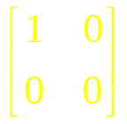
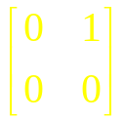
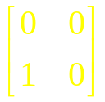
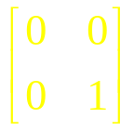
(c) The set of 2 x 2 matrices with real entries (elements) {u1, u2, u3, u4} where
u¹ = ,u² = ,u³ = ,u⁴ = is a linearly independent and every 2 x 2 matrix with real entries can be expressed as their linear combination. Therefore they form a basis for the vector space M_{2X2}. This basis is called the standard basis for M_{2X2} dim (M_{2X2}) = 4.

Slide 16
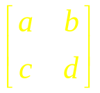
Example 3
Let W be the subspace of the set of all (2 x 2) matrices defined by
W = {A = 2a– b + 3c + d = 0}.
Determine the dimension of W.

Slide 17


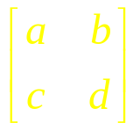
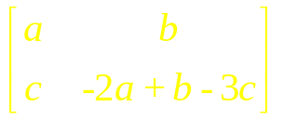
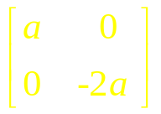
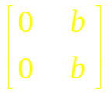
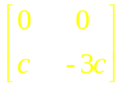
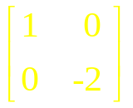
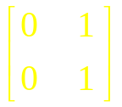
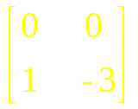
Solution The algebraic specification for W can be rewritten as d = -2a + b – 3c.
Now A =
=
= + +
=a +b +c
= a A¹ + bA² + cA³

Slide 18
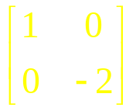
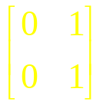
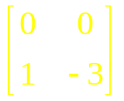
Where A¹ = , A² = , and A³ =
The matrix A is in W if and only if A = a A¹ + b A² + c A³, so {A¹, A², A³} is a spanning set for W. It is easy to show that the set {A¹, A², A³} is linearly independent, so it is a basis for W. It follows that dim (W) = 3.

Slide 19
Note
dim ( R^{n} ) = n
dim ( P_{n} ) = n + 1
dim ( M_{mn} ) = mn

Slide 20
Examples

Slide 21
Bases for
Nul A and Col A

Slide 22
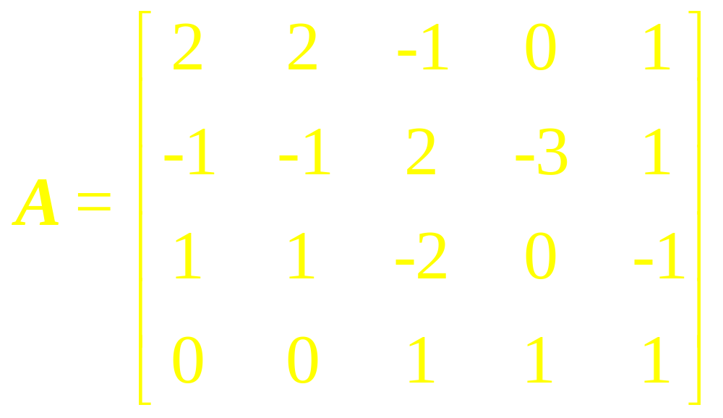
Example 7
Find a basis for the null space of

Slide 23
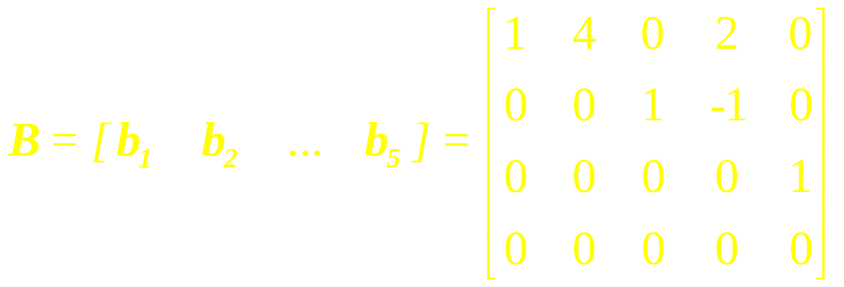
Example 8
Find a basis for Col B, where

Slide 24
Note
Elementary row operations on a matrix do not affect the linear dependence relations among the column of the matrix.

Slide 25
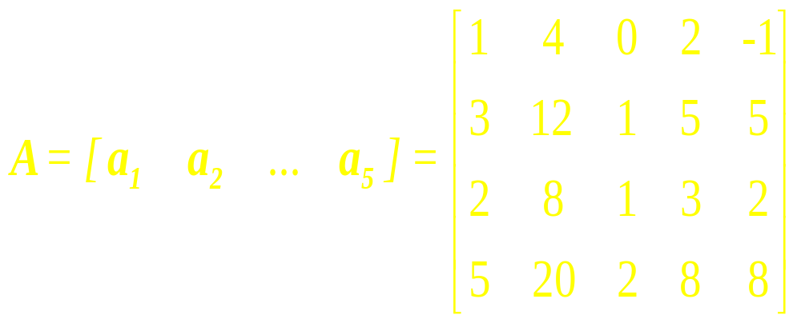
Example 9
Find a basis for Col A.

Slide 26
Theorem
The pivot columns of a matrix A form a basis for Col A.

Slide 27
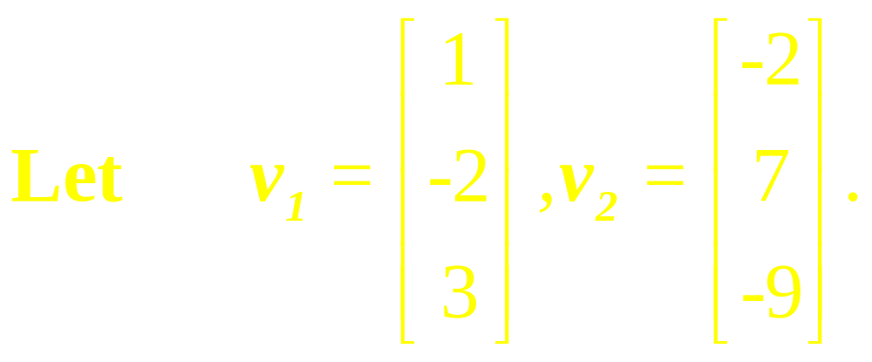
Example 10
Determine if {v₁, v₂} is a basis for R³. Is {v₁, v₂} a basis for R²?

Slide 28
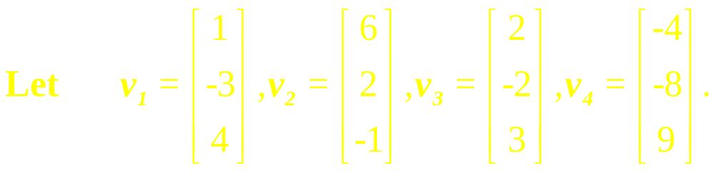
Example 11
Find a basis for the subspace W spanned by {v₁, v₂, v₃, v₄}

Slide 29
Procedure:
Basis and
Linear Combination

Slide 30
Example 12
(a) Find a subset of the
vectors v₁ = (1, -2, 0, 3),
v₂ = (2, -4, 0, 6), v₃ = (-1, 1, 2, 0)
and v₄ = (0, -1, 2, 3) that form a
basis for the space spanned
by these vectors. …

Slide 31
continued
(b) Express each vector not
in the basis as a linear
combination of the basis
vectors.

Slide 32
Theorem
Let H be a subspace of a finite-dimensional vector space V. Any linearly independent set in H can be expanded, if necessary, to a basis for H. Also H is finite-dimensional and dimH < dimV

Slide 33
The Basis
Theorem

Slide 34
Let V be a p-dimensional vector space, p> 1. Any linearly independent set of exactly p elements in V is automatically a basis for V. Any set of exactly p elements that spans V is automatically a basis for V.

Slide 35
Dimensions of
Nul A and Col A

Slide 36
The dimension of Nul A is the number of free variables in the equation Ax = 0.
The dimension of Col A is the number of pivot columns in A

Slide 37
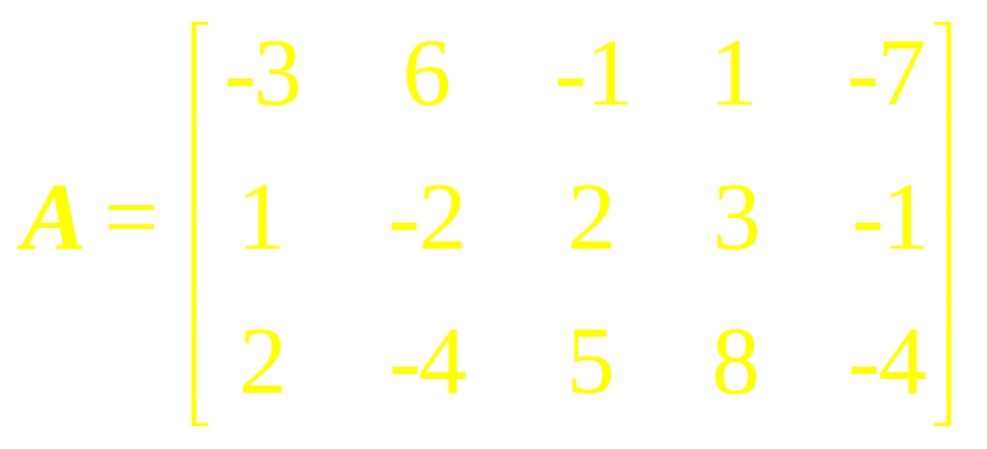
Example 15
Find the dimensions of the null space and column space of

Slide 38
Example 16
Decide whether each statement is true or false, and give a reason for each answer. Here V is a nonzero finite-dimensional vector space. …

Slide 39
1. If dim V = p and if S is a linearly dependent subset of V, then S contains more than p vectors.
2. If S spans V and if T is a subset of V that contains more vectors than S, then T is linearly dependent.

Slide 40

Solution
(1) False. Consider the set {0}.
(2) True. By the Spanning Set
Theorem, S contains a basis
for V; call that basis . Then T
will contain more vectors than
. T is linearly dependent.

Slide 41
Linear Algebra
Lecture 24

